Slide 1
Chicago Crimes
Susheel Reddy Gurrala WX91253

Slide 2
My motivation towards this project is, I want to analyze on Chicago crimes to know the exact number of crimes and types of crimes occurred in Chicago during the period of 2001-2021.
Project Motivation
Here we can know the number of crimes occurred in a day or in a month or in a year, so that this is helpful to reduce the crime-rate in Chicago.
While doing this project there is a drastic change in growth of crimes in between the years 2015 and 2016, And most of the crimes are thefts.

Slide 3
Problem Statement
I want to take “Arrest “ as my target variable to classify the models. Observe the visualization while working on the data I came to know that there is very low arrest rate.
I want to find out the score accuracy of Arrest rate using different hyperparameters and models.

Slide 4

Exploratory Data Analysis(EDA)

Slide 5
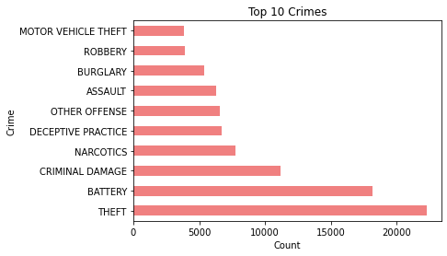
Top 10 Crimes
This is the visualization for top 10 crimes in Chicago.
If we observe here the highest crime occurred in Chicago is “Theft”.

Slide 6
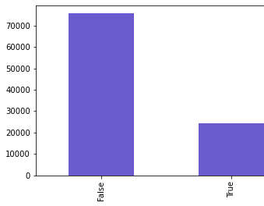
Arrest Rate
The visualizations shows the arrest rate.
True represents the people arrested in Chicago. There are very less people who are arrested.

Slide 7
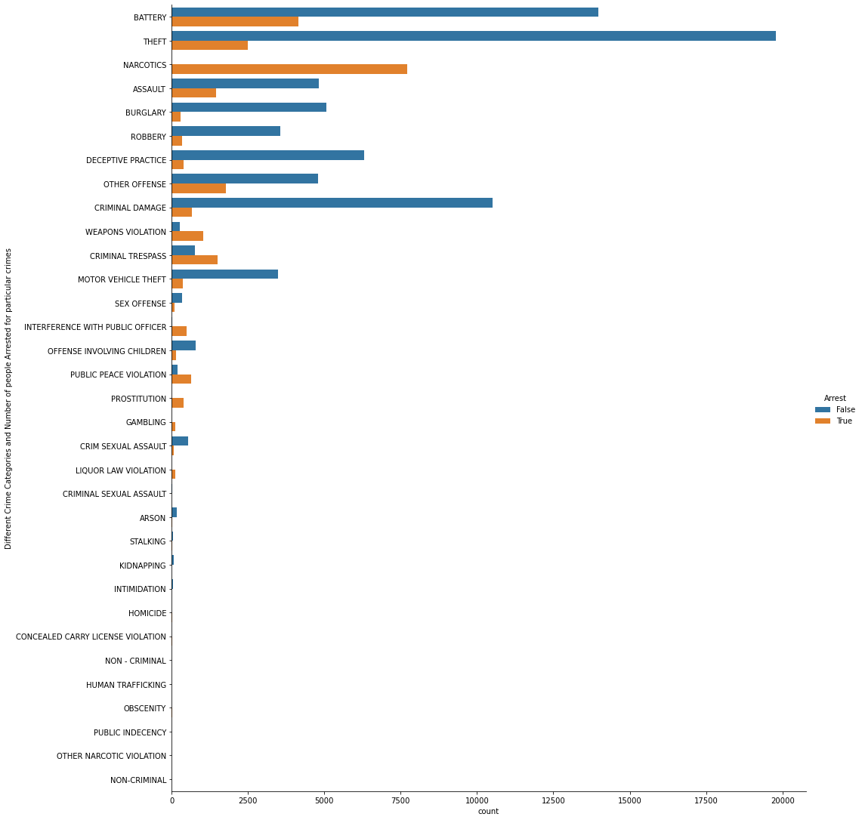
Arrest depending on Crime
The visualization shows the number of people arrested depending upon the crime.
Here if we observe, most of the people got arrested who are involved in crime “NARCOTICS”.

Slide 8
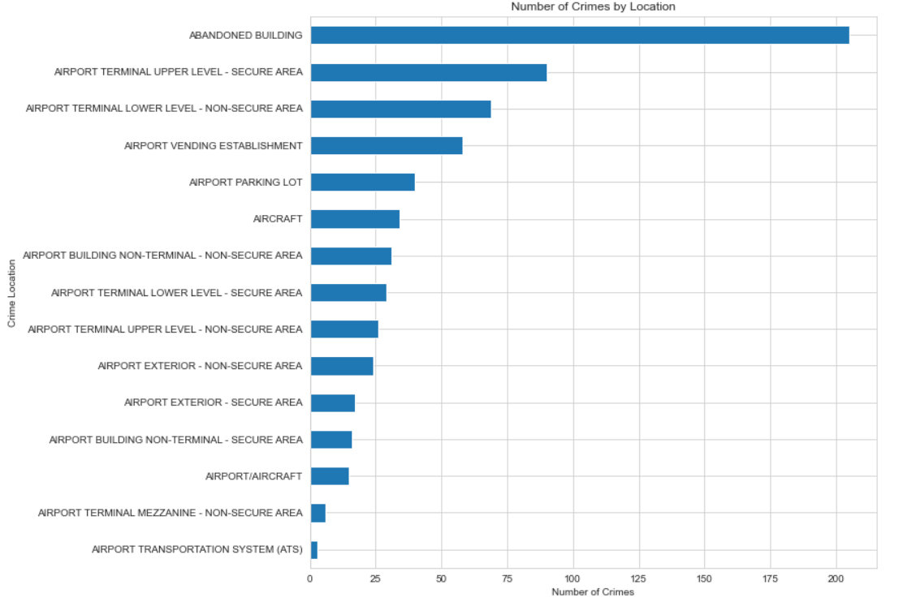
Crimes By Location
Here in this visualization, we can observe the crimes occurred by location and the large number of crimes occurred in Abandoned Building.
And the least number of crimes occurred in Airport Transportation System

Slide 9
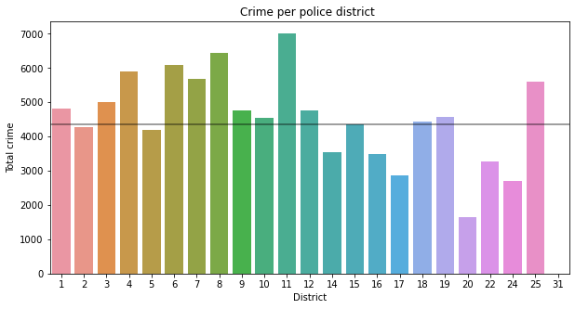
Crimes per police district
Here the visualization shows crimes per police district .
Most of the crimes happened in the “11”
district.
And the least crimes occurred in 20 police district.

Slide 10
Models And Results

Slide 11




Logistic Regression Classifier:
Logistic Regression is the most basic model that usually works on any data frame and the scores given by the logistic regression are accurate depending upon my data set.
Decision-Tree-Classifier:
I have chosen this because as I have more categorical data,It is useful to derive as it has feature of capturing the descriptive decision-making skills.
KNN- Model:
I have chosen this as it is a simple supervised algorithm where we can assign the class to new data point, and it is non- parametric model.
Chosen Models

Slide 12



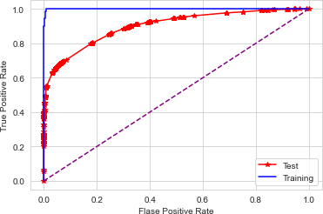
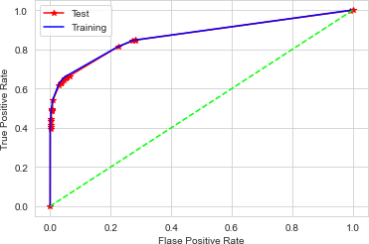

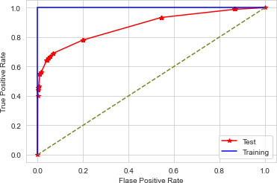
ROC Curves for 3 models
Logistic Regression Classifier
Decision-Tree-Classifier
KNN- Model

Slide 13
Logistic Regression Classifier:
Scores
ROC-Accuracy Score: 90.20%
Logistic Regression score: 88.60%
F-1 Score: 72.96%
Decision- Tree – Classifier:
ROC-Accuracy Score: 86.98%
Decision-Tree Score: 88.45%
F-1 Score: 72.28%
KNN- Model Classifier:
ROC Accuracy Score: 87.63%
KNN- Model Score: 88.08%
F1-Score: 68.67%

Slide 14
Comparing Models
Logistic regression performs well among the decision tree model and KNN-model.
The roc accuracy score is higher for the logistic regression as it maintains 90.01%
And comparing the F1 score among the models here also the logistic regression is best with 72.96%.
Coming to the crimes most of the crimes are theft based, in 10th district the crimes are high and most of the crimes occurred in 10th month i.e., October.

Slide 15


A typical approach is, to improve a model to use more data. In this case, I have only taken the chunk data i.e., 100000 but including whole can improve the overall score as taking the chunk lot of data got missed like number of years or months.
We could try various techniques, such as neural network, but this could lead to additional problems and is overkill.
For more exploration we can use ensemble models, by using this the scores may get improved.

Slide 16


THANK YOU

